Slide 1
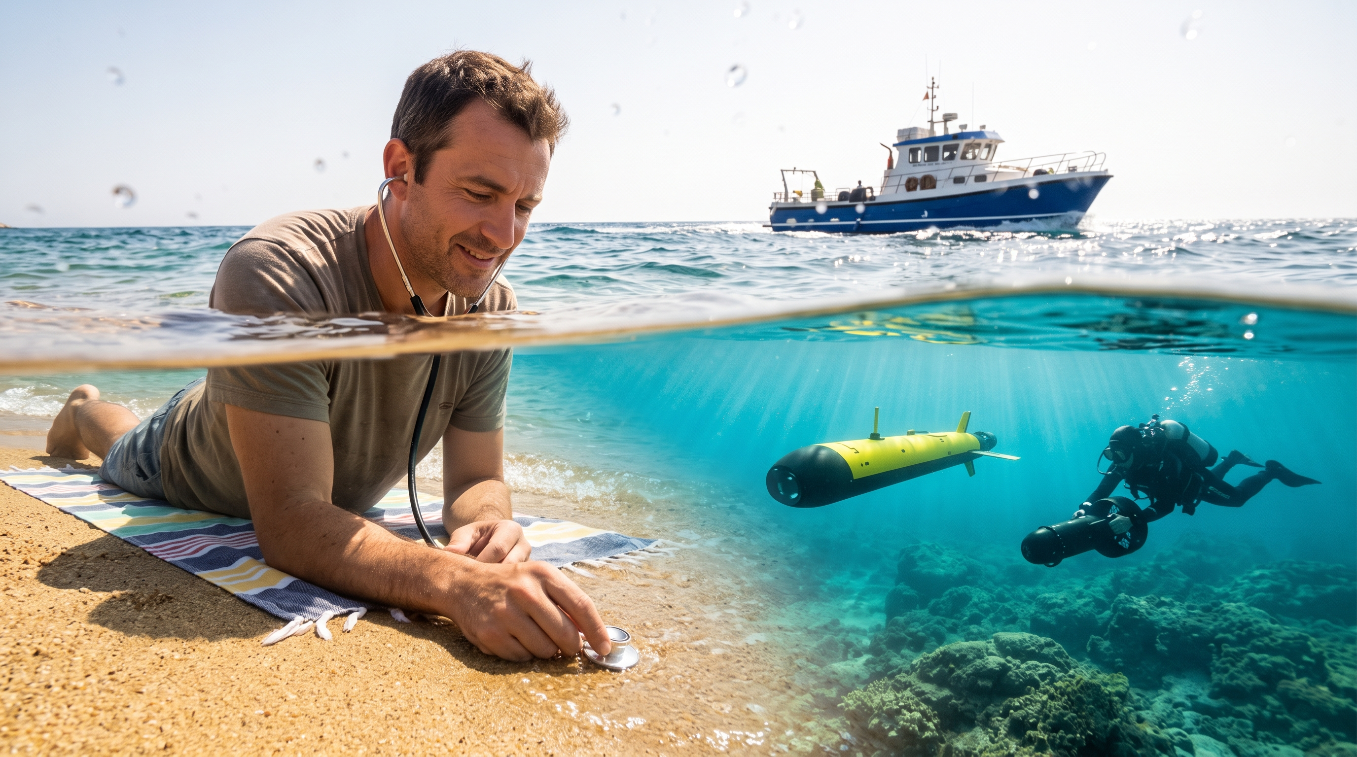
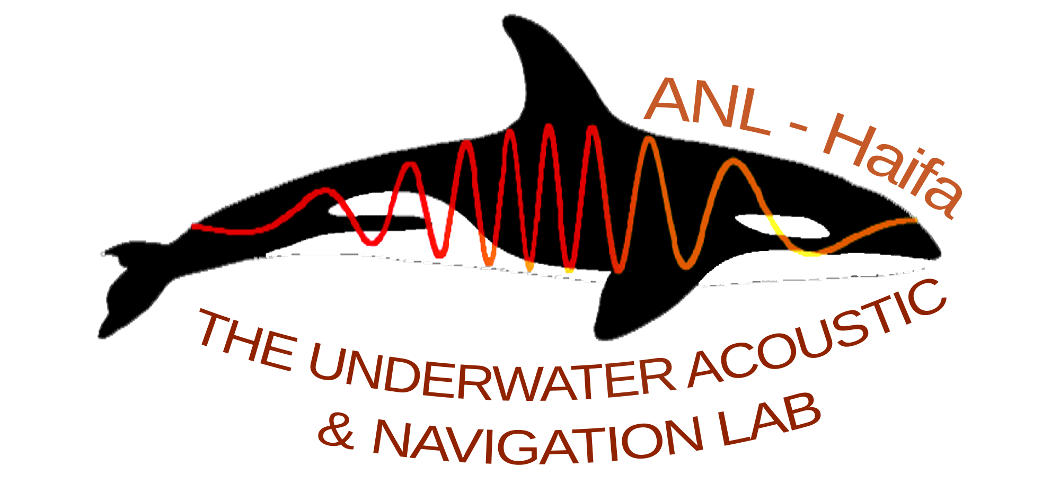

Physics Informed Machine Learning Vessel Depth Classification
The Acoustic Environment: Sound is the primary medium for marine sensing.
The Core Challenge: Distinguishing whether an acoustic source is floating or operating underwater using a passive hydrophone.
The Approach: Leveraging physics-informed machine learning
Roy Michael
Notes:
We’ve all been there: sitting on our private island, putting a hydrophone in the ocean and listening to the ambient noises.
when suddenly, you hear a distant noise, and you're not sure if it's your new yacht being delivered or James Bond arriving underwater to challenge your security system.
Hi everyone, my name is Roy and I am from the Acoustics and Navigation Lab at Haifa University, and I decided to tackle this issue before finally buying my first island.
Jokes aside, the only way we can truly “see” underwater, is using sound which can travel thousands of meters.
What I wanted to know was: can sound help me understand not only where vessels are but also how deep they are.
This research focuses on determining whether a sound source is coming from above or under water. We did this using a physics-based model of sound propagation.
Once we have clear features of the sound sources, we can use Machine Learning to build a “detector” and create a robust tool to address this challenge.

Slide 2
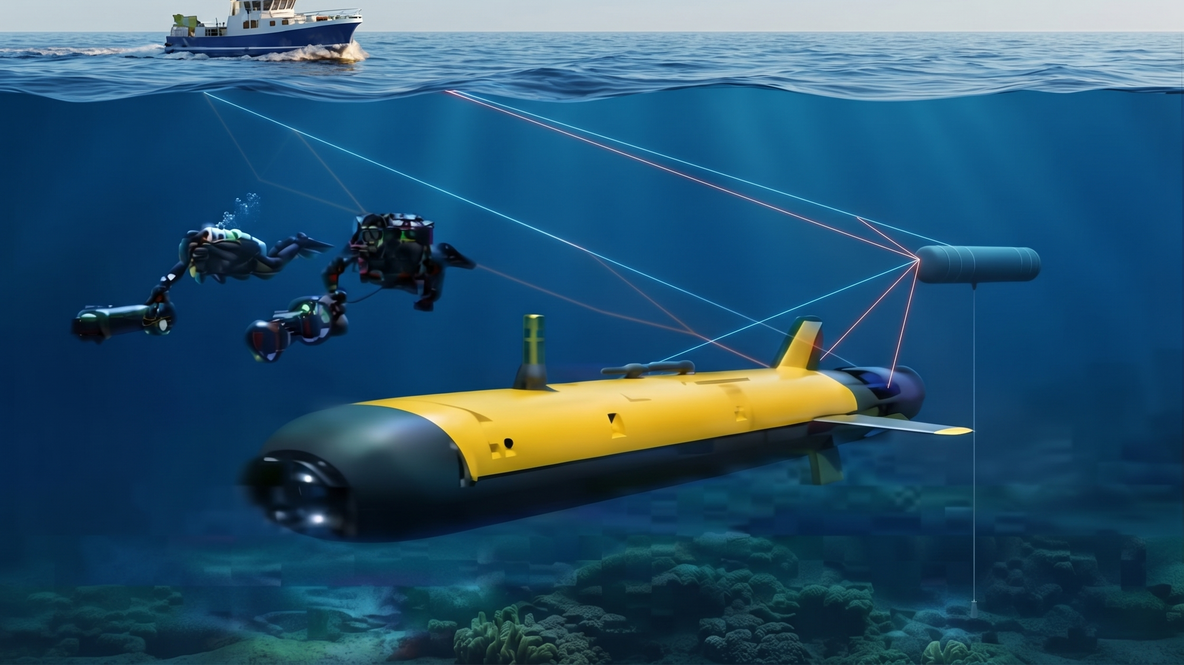
The Physical Model (or Why Waves Make Surface Vessels Sing Off-Key)
Surface Alteration: Surface wave motion alters source frequencies and creates interfering reflections.
Surface Signal Behavior: Broader spectral distributions, Doppler expansion, signal fading, and reduced persistency.
Submerged Signal Behavior: Stable direct tonal band accompanied by a cleaner, delayed surface echo.
Notes:
So, how do we tell vessels apart?
The secret lies in how the ocean surface alters sound signals, causing surface vessels to behave differently from underwater ones.
You can think about it this way:
Sounds from a boat on the water are like singing while riding a
roller-coaster, the noises go up and down and echo from around you.
An underwater vessel in this case will be like singing in a professional studio: it produces a pure and steady tonal band.

Slide 3
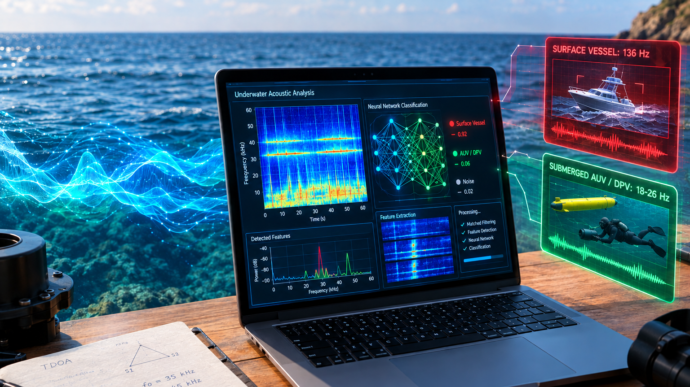
From Raw Sound to Smart AI Classification
Spectral Bandwidth Separation: Surface vessels average 136 Hz in bandwidth, submerged vessels maintain narrow bands of 18–26 Hz.
Temporal Persistence Metrics: Clear differences in persistency measured over varying conditions.
Takeaway & Impact: Robust features were extracted, allowing for real-time ML classification.
Notes:
Well, we took a few boats and underwater scooters and through them in the water and analyzed the data.
And indeed, we found specific features for each vessel type:
The surface vessels had a broad bandwidth with significant variances.
On the other hand - the submerged vessels showed a narrow bandwidth, maintaining stability in various conditions.
Now that we have clear features, we can feed them into a machine learning model.
This model will separate vessels over and under water and give us a 3D view of ocean traffic.
And I can finally buy my island!
Thank you!

